Slide 1
Multi- Agent Medical Image Analyzer

Slide 2
Introduction:
Medical imaging plays a critical role in diagnosing various conditions. However, with increasing patient loads, radiologists face challenges like fatigue, delayed reporting, and the potential for human error. To address this, we propose an AI-powered Medical Image Analyzer —to support radiologists by interpreting X-rays and MRIs.

Slide 3
Features
Multi-Agent System: Dedicated agents for analyzing medical images and historical reports with Image Analyzing agent, Diagnosing agent,Predicting agent based on medical history.
Automated Image Analysis: Detects abnormalities like tumors, fractures, or anomalies.
Visual Focus: Highlights critical areas within X-rays or MRIs.
Medical History Integration: Reads past reports and correlates with current findings.
Explainability: Outputs clear, structured reports with disclaimers and suggested next steps.
Confidence Scores & Recommendations: Adds medical suggestions with diagnostic confidence.

Slide 4
Methodology
Model Selection:
Leveraged Gemini 1.5 Pro for language/image reasoning.
Used safety settings to ensure medically responsible responses.
Prompt Engineering:
Separate detailed prompts for X-ray analysis and History report reading agents.
Incorporated clinical language, structured reporting, and disclaimers.
Frontend:
Built using Streamlit with a modern UI.
Supports image and PDF/text uploads, displays annotated results.
Data Handling:
Accepts JPEG, PNG for images and TXT/PDF for historical reports.
Uses PyMuPDF for parsing PDFs.

Slide 5
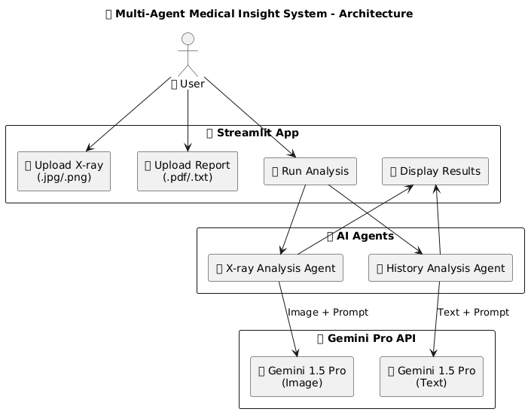
Architecture

Slide 6
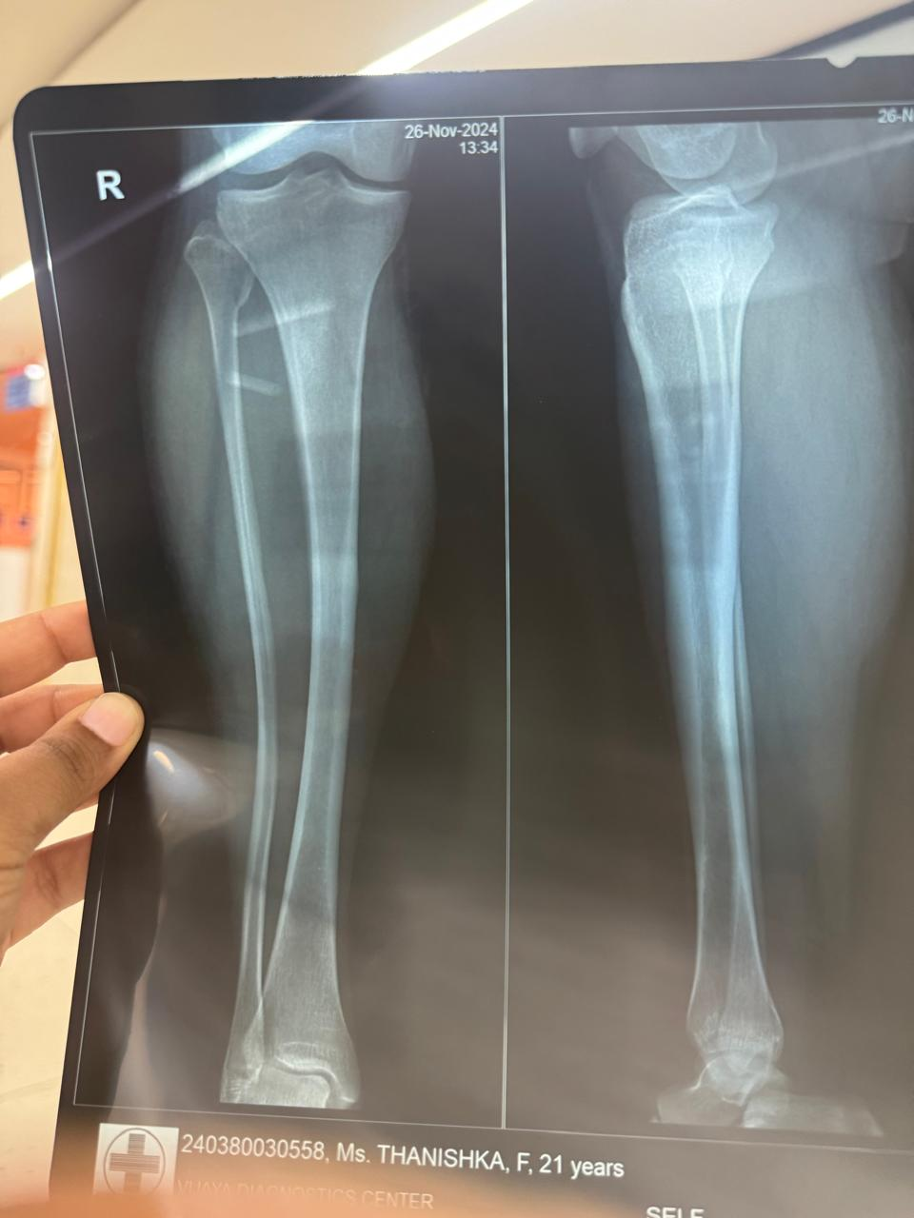
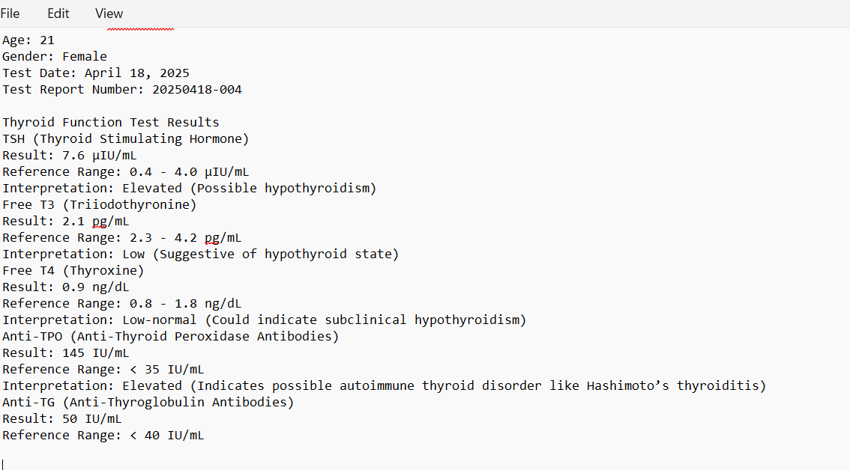
Results Input

Slide 7
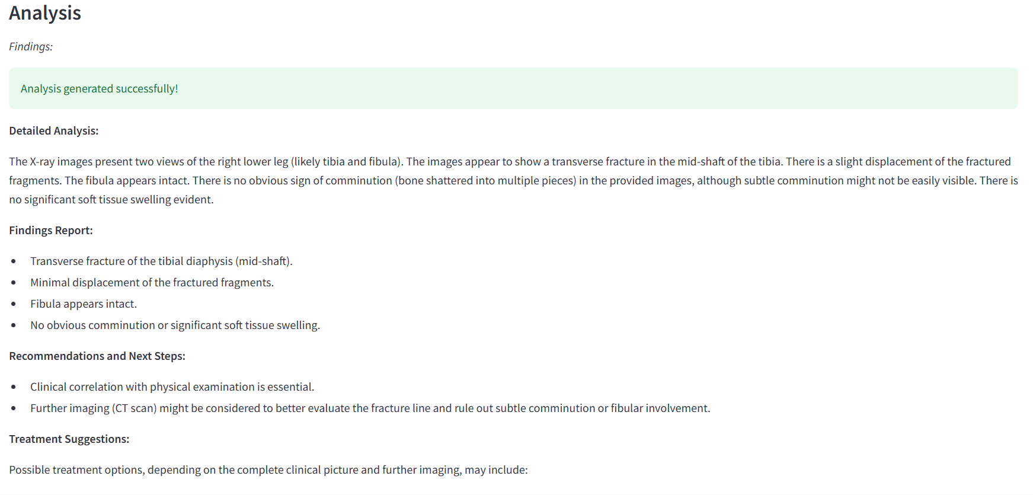
Results output

Slide 8
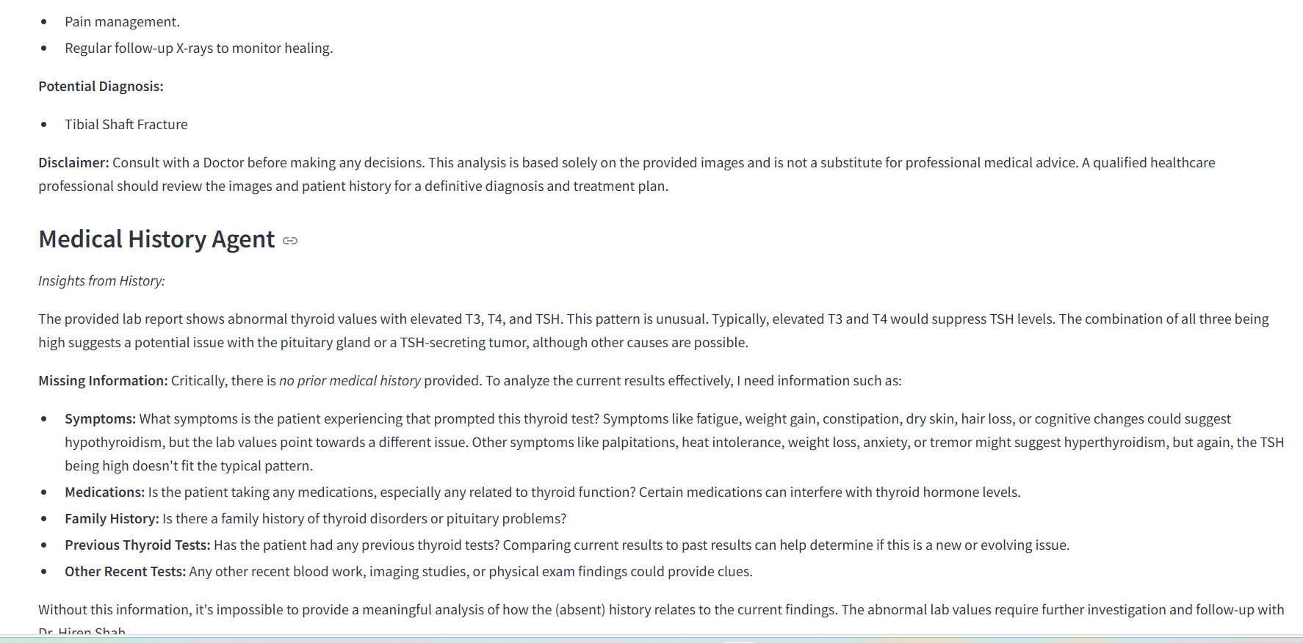

Slide 9
Conclusion
This AI-powered system acts as an efficient assistant for radiologists, improving diagnostic accuracy and saving time. By leveraging deep learning, prompt engineering, and a multi-agent approach, we bridge the gap between high-volume diagnostics and high-quality care.
Future Enhancements:
Model fine-tuning on domain-specific datasets
Annotation overlays on images
Integration with hospital management systems
Tracking Progress from the previous medical Reports

